Slide 1
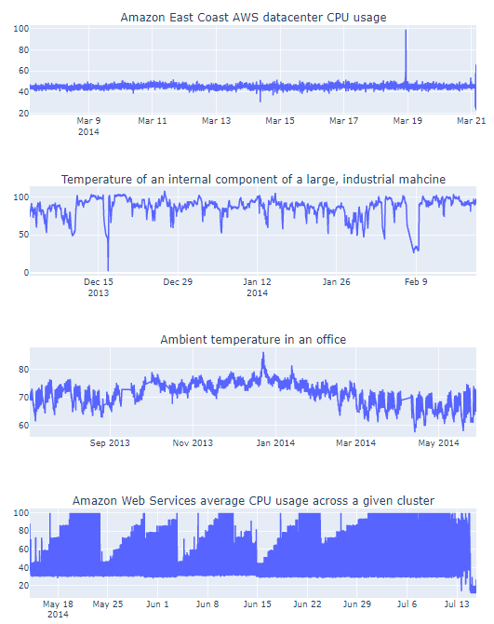
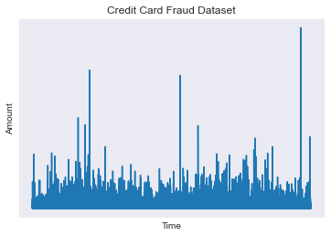
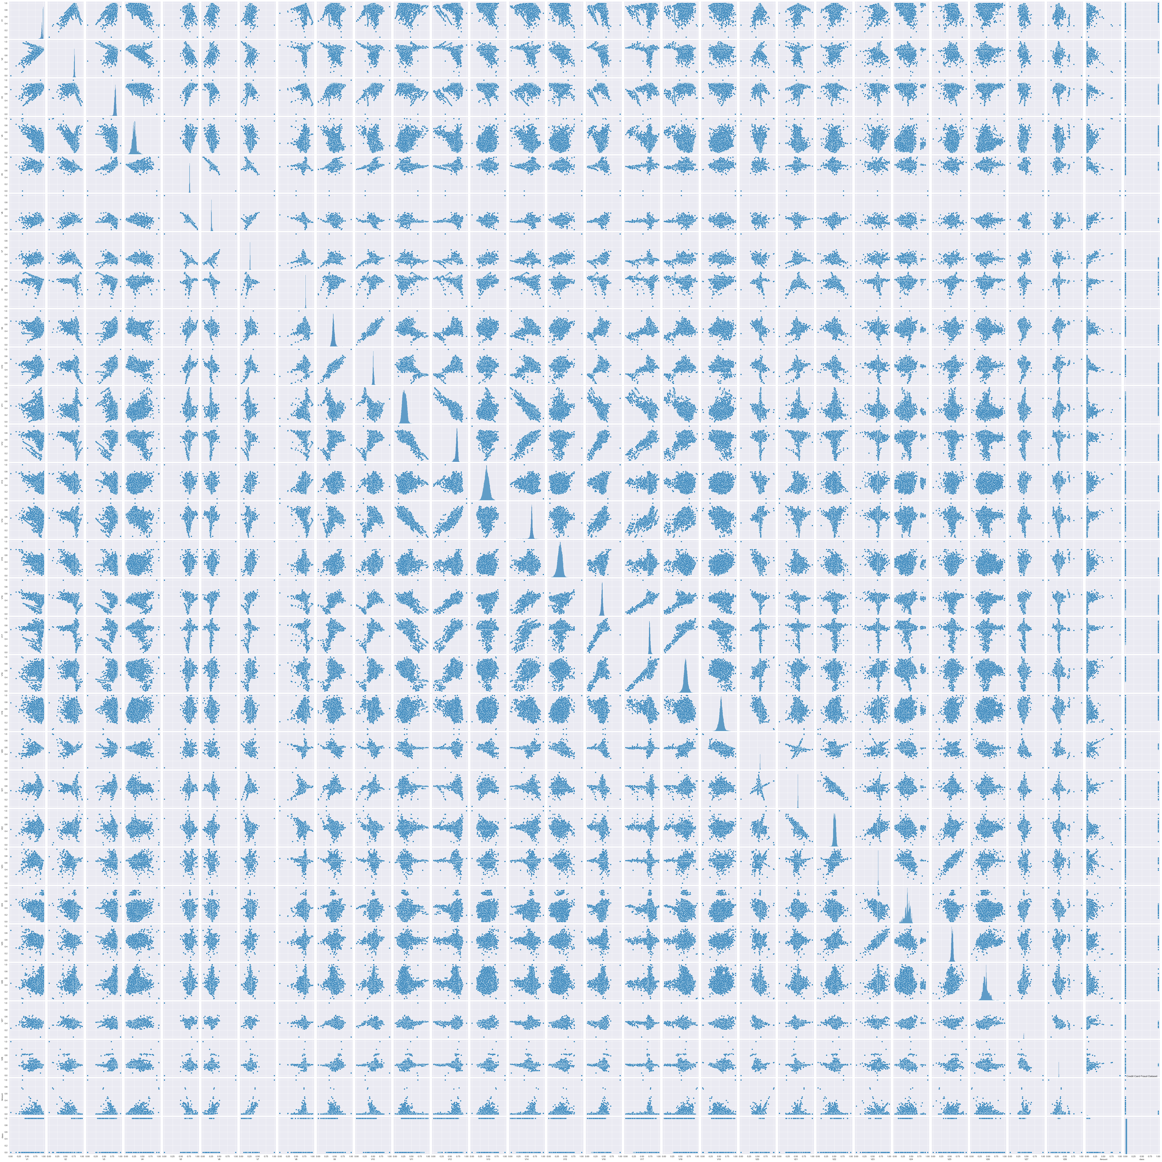
Anomaly detection with supervised and unsupervised machine learning techniques
Credit Card Fraud Dataset

Slide 2
Methodology
Unsupervised data
Supervised data
Feature Engineering
Dimensionality Reduction using PCA
K-means Clustering
Gaussian Naïve Bayes with Clusters
Isolation Forest
One Class Support Vector Machine
Deep Learning:
LSTM
GRU
Applications of unsupervised techniques
Logistic Regression
KNN
SVC
Decision Tree

Slide 3
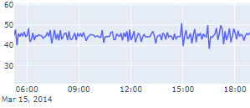
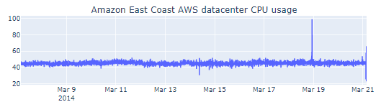
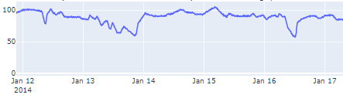
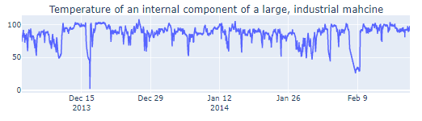
Feature Engineering
Amazon East Coast AWS Datacenter CPU usage:
Minutes
Hours
Day
Temperature of Industrial Machine component:
Hours
Day

Slide 4
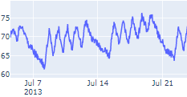
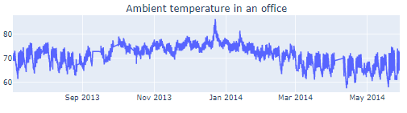
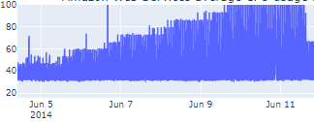
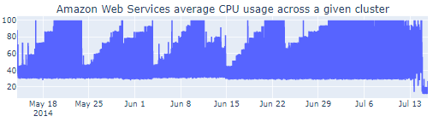
Feature Engineering
Ambient temperature in an office:
Hours
Day
Working Hours
Weekday
AWS average CPU usage across a given cluster:
Hours
Day
Weekday

Slide 5
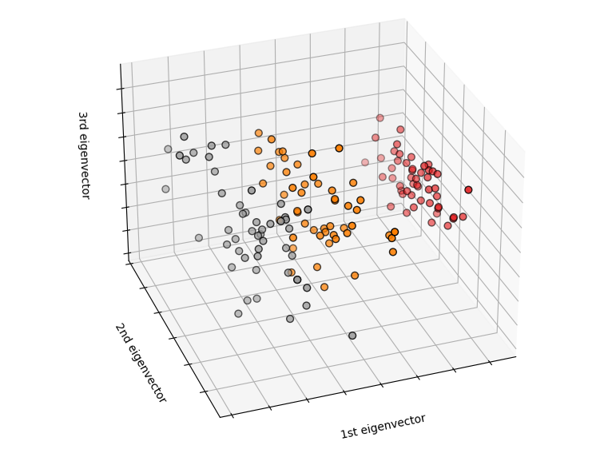
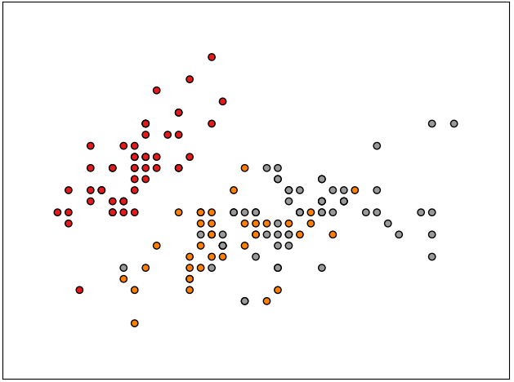
Principal Component Analysis
PCA
Images taken from:
https://scikit-learn.org/stable/auto_examples/datasets/plot_iris_dataset.html#sphx-glr-auto-examples-datasets-plot-iris-dataset-py

Slide 6
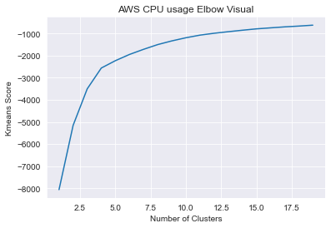
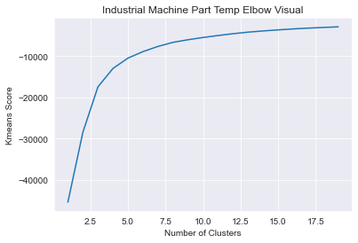
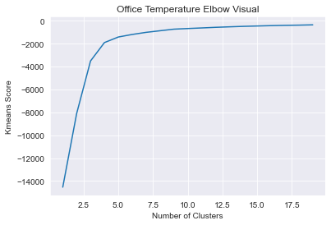
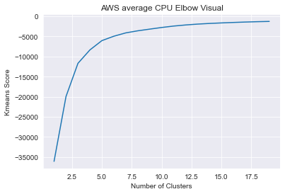
K-means Clustering
Clusters = 4
Clusters = 6
Clusters = 5
Clusters = 5

Slide 7
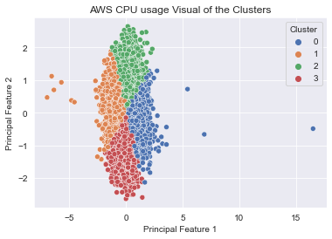
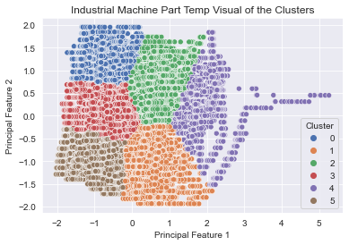
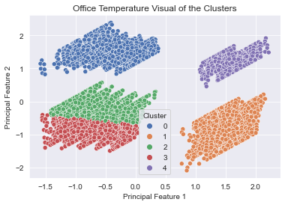
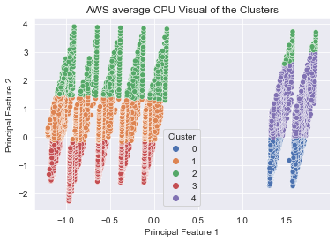
K-means Clustering

Slide 8
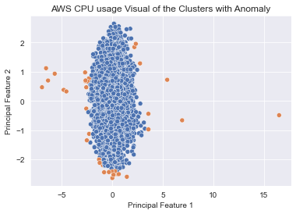
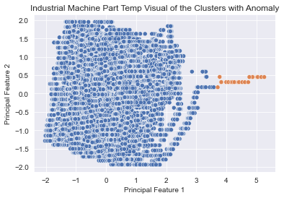
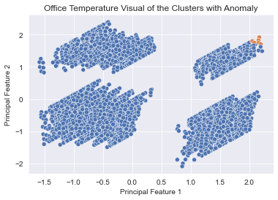
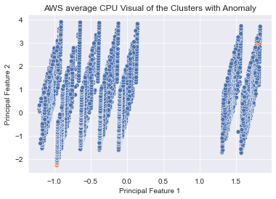
Anomaly Detection with centroid distance measure

Slide 9
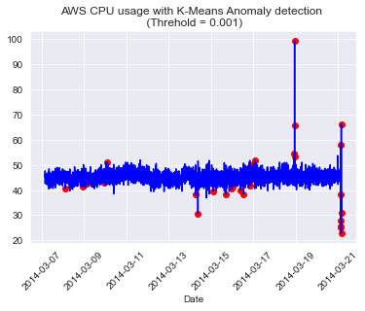
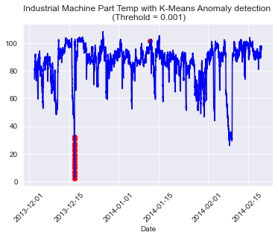
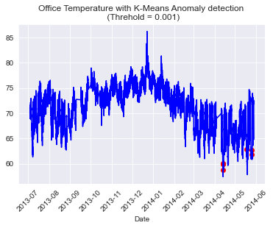
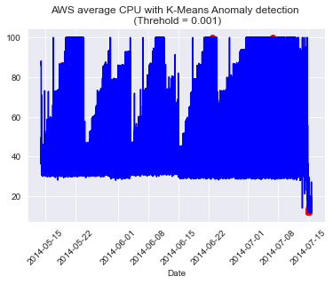
Anomalies detected using K-means Clustering

Slide 10
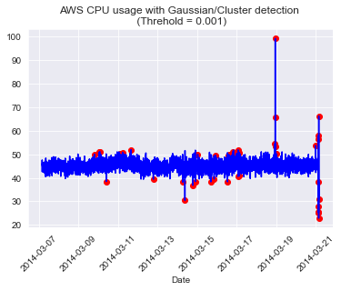
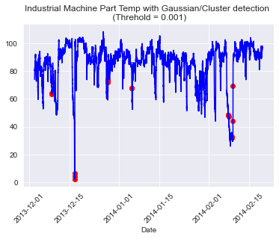


Anomaly Detection by applying the Gaussian distribution to the clusters

Slide 11
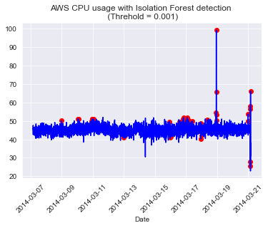
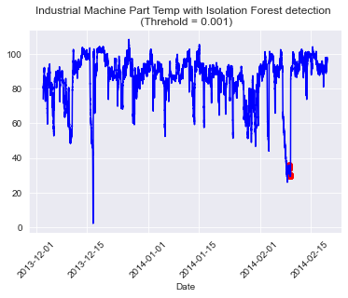
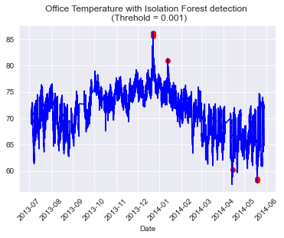

Anomaly Detection using Isolation Forest

Slide 12
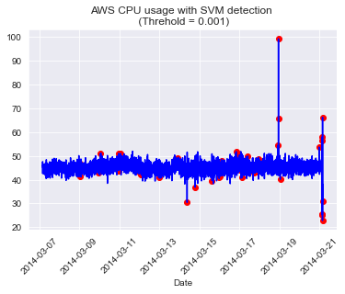
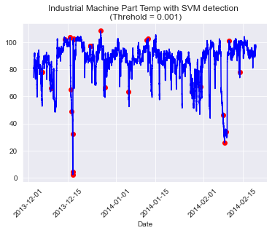
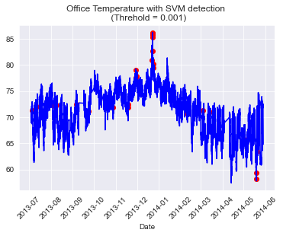
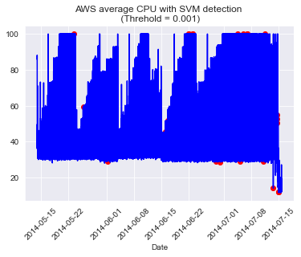
Anomaly Detection using One Class SVM

Slide 13
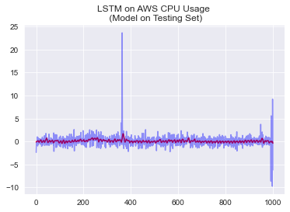
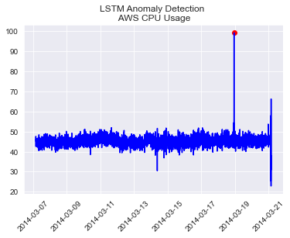
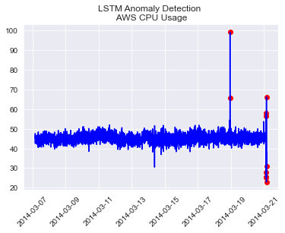
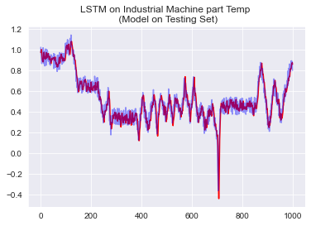
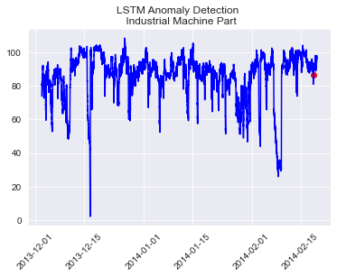
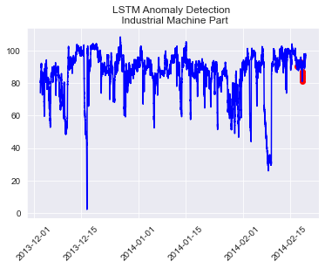
Anomaly Detection using LSTM Neural Networks
Outlier Fraction = 0.001
Outlier Fraction = 0.01
1 Anomaly detected
10 Anomalies detected
1 Anomaly detected
10 Anomalies detected

Slide 14
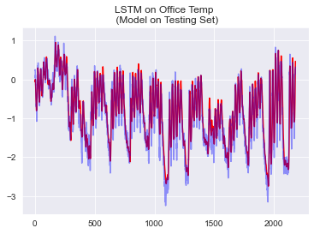
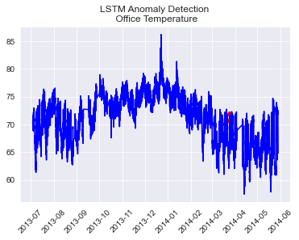
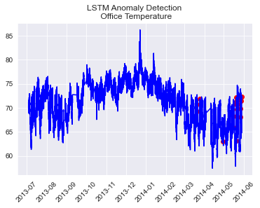
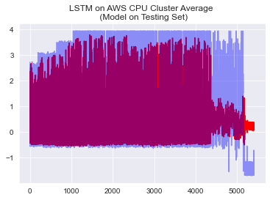
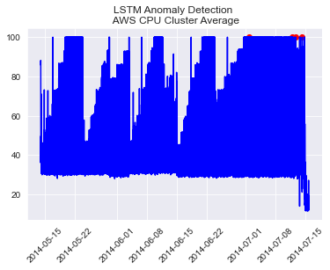
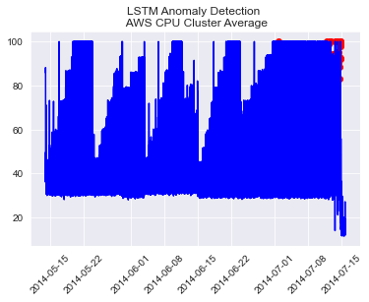
Anomaly Detection using LSTM Neural Networks
Outlier Fraction = 0.001
Outlier Fraction = 0.01
2 Anomalies detected
21 Anomalies detected
5 Anomalies detected
54 Anomalies detected

Slide 15




Credit Card Fraud Dataset
Outlier Fraction = 0.001
Clusters = 5

Slide 16


Credit Card Fraud Dataset
Outlier Fraction = 0.01
Clusters = 5
Increased TP, decreased TN
Decreased FN –
missing less occurrences of fraud
Increased FP –
identifying no purchase as fraud more often

Slide 17


Credit Card Fraud Dataset
Outlier Fraction = 0.001
Outlier Fraction = 0.01
Increased TP, decreased TN
Decreased FN –
missing less occurrences of fraud
Increased FP –
identifying no fraud as fraud more often

Slide 18


Credit Card Fraud Dataset
Outlier Fraction = 0.001
Outlier Fraction = 0.01
Increased TP, decreased TN
Decreased FN –
missing less occurrences of fraud
Increased FP –
identifying no fraud as fraud more often

